Slide 1
Nextflow fundamentals training
Albert Palleja Caro
on behalf of
Data Science Platform
27th November 2024

Slide 2
Outline of the theoretical part
What is Nextflow?
Behind nextflow
Why do we need a Community effort?
Nextflow - Basic concepts
Nextflow’s core features
A Nextflow script
Installing Nextflow and running the first scripts
Nextflow and Azure batch
nf-metagenomics pipeline
Resources

Slide 3

Context
Experiments and analyses on large datasets
Portable
Big Data
Reproducible
Workflows: using computers to collect, store and analyze and disseminate data information
Handle small and large files (e.g. genomics)
Many programmimg languages and different softwares
Complex interactions and dependencies between the softwares
Parallellize jobs
Distribute computing
Great support for all that!
Notes:
The rise of big data has made it increasingly necessary to be able to analyze and perform experiments on large datasets
We want to do that in a portable and reproducible manner. So that you can run your analysis in the laptop or in an HPC or in the cloud and that the results are the same
Workflow collect, store and analyze data! We want our workflows to handle different file sizes and formats, many programming languagues or softwares, interaction and dependencies between these softwares and the code should parallel and distribute it on different cpmputting enviromnets Nextflow addresses these challenges that allow us to build the workflows and has a strong supportive community behind.

Slide 4
Nextflow is a software - Workflow orchestrator engine
Nextflow is a Domain-specific language (DSL) built on top of Groovy
It allows writing data-intensive computational workflows
It accommodates many languages, software environments, and computing environments
It is oriented to bioinformatics analyses
There is an active community giving support, organizing trainings and developing and maintaining 113 different bioinformatics analyses (on date: 27th November 2024)

Slide 5

Behind Nextflow
#Open Science
Make science more open!
Notes:
Keyword behind Nextflow and technologies related:
Open science - Is a current movement! Make Science more open! Nextflow is helping on that!

Slide 6

Behind Nextflow
Open source
We need to know software, params, options, method used and have access to the source code to be sure of what we are doing.
Nextflow is open source.
Notes:
To have open science we need to know software, params, options, method used and have access to the source code to be sure of what we are doing. Nextflow is opn source.

Slide 7
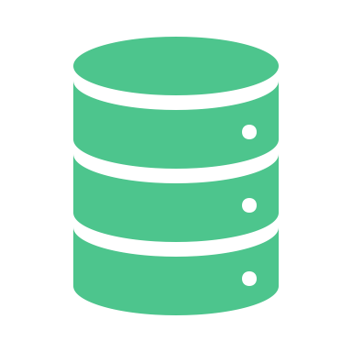
Behind Nextflow
Open Data
Which data are we handling?
How was our data measured, which technology generated it, what are the units, etc…
Findable, Accessible, Interoperable, Reusable (FAIR) data
Notes:
Also important to have open data, how was our data measured, from which technology was obtained, what are the units, where to find it how to access it

Slide 8

Behind Nextflow
Open community
Nextflow advocates for an open community with multiple channels to interact and connect people, forums, Slack channels, conferences, hackathons regularly organize
nf-core initiative have developed, curate and maintain 118 bioinformatics pipelines
Notes:
If you have open science, open source and open data then Nextflow to orchestrate the anaylses then you have an open community.
Nextflow advocates for an open community with multiple channels to interact and connect people, forrums, Slack channels, conferences, hackathons regularly organized
Nf-core initiative develop, curate and maintain > 100 bioinformatics pipelnes, for example in nf-core collection of nesxtflow pipelines)

Slide 9

Behind Nextflow
Genomics workflows
First Nextflow pipelines built for Genomics data processing characteryzed by large files per samples, different formats (binary, tab separated, etc..) parallel processess, different sorftware and languages (python, R, matlab, …) involved, nedd to take decisions for the next processes
Nextflow can handle all that
Notes:
Originally thought for Genomics data with large files and heterogeneity of the data
Files in different formats and sizes
Parallel process
Different software
Different programming languages
Decisions may be need to be taken at some point of the pipeline on the fly, this software or another, etc…
Nextflow can handle all that!

Slide 10
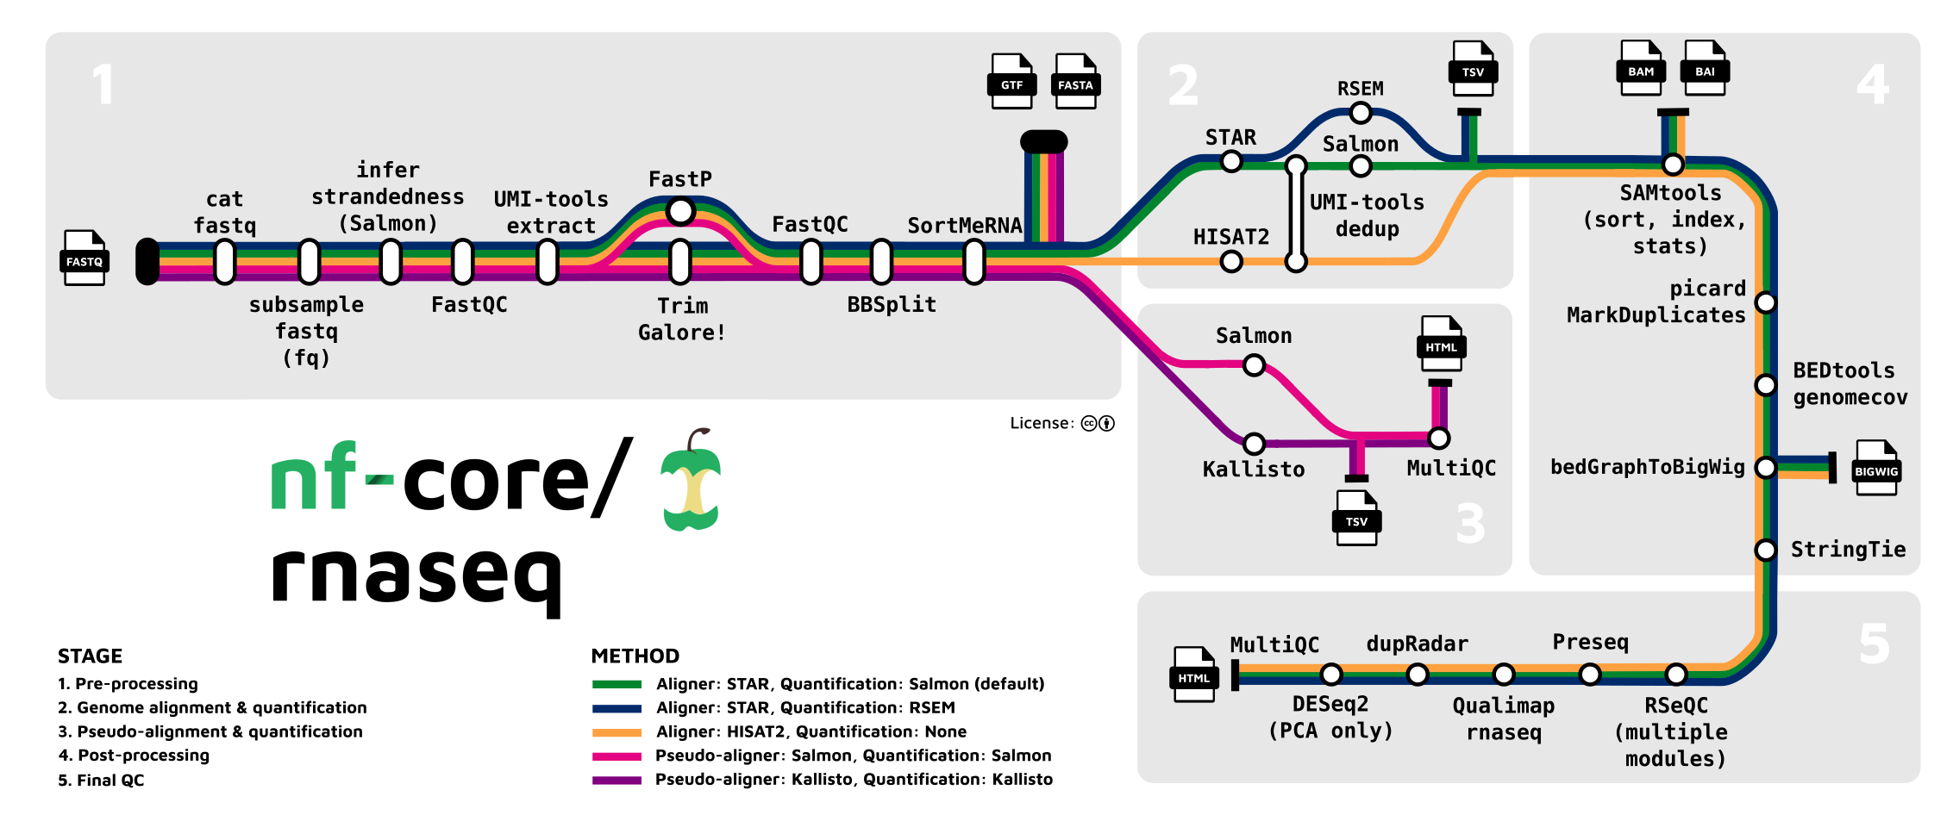
A nextflow pipeline in metro map
Notes:
Here I wanted to show an example of a Nextflow pipeline, this one is called nf-core pipeline rnaseq and as it names indicates it is to process RNAseq data.
Usually Nextflow pipelines are represented in these metromaps.
And as you can see here the pipeline has different input data to start and from different points, it covers different stages of RNA seq processing, inside the pipelines
Each node is a different process and the output of the processes become the input of the next process. You can have also different final results

Slide 11
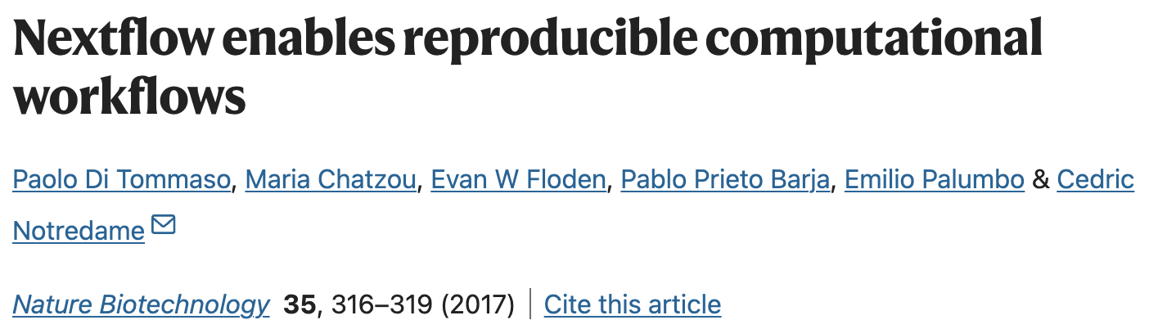
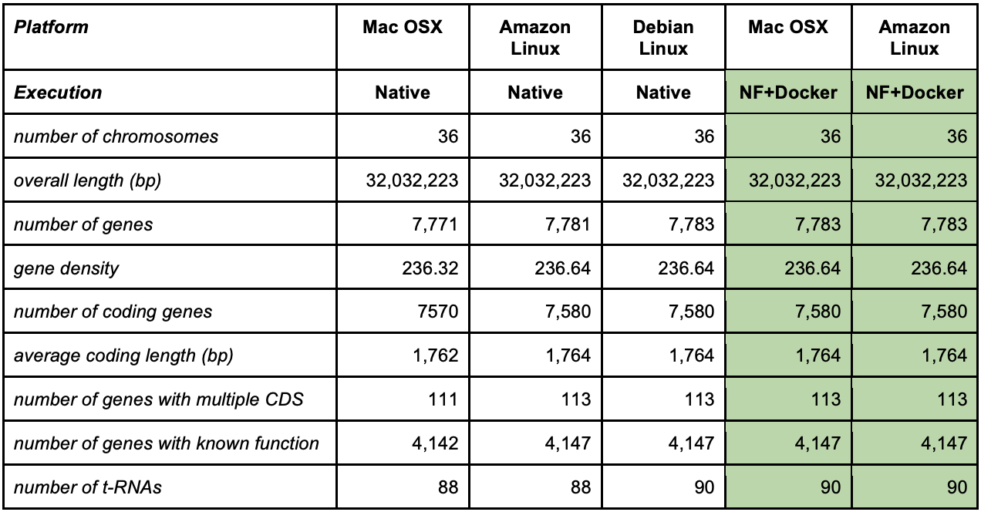
Why do we need a Community effort?
Reproducibility and even repeatability is challenging even if you are very careful keeping the same, params, versions, etc…!!!
Gene annotation differences depending on which operation system the pipeline was executed
This did not happen when using Nextflow + Docker on different environments
Notes:
But why do we need such a community effort as the one supporting and sustaining Nextflow?
Reproducibility and repeatability are very challenging even if you are very careful with what you do.
One of the initial papers describing Nextflow they showed differents in gene annotation of genes depending on which environment the pipeline was executed. See the differences running in Mac, Amazon Linux or Debian Linux. And how the results were the same running in Mac or Amazon using Nextflow in a containerazed environement (Docker)

Slide 12
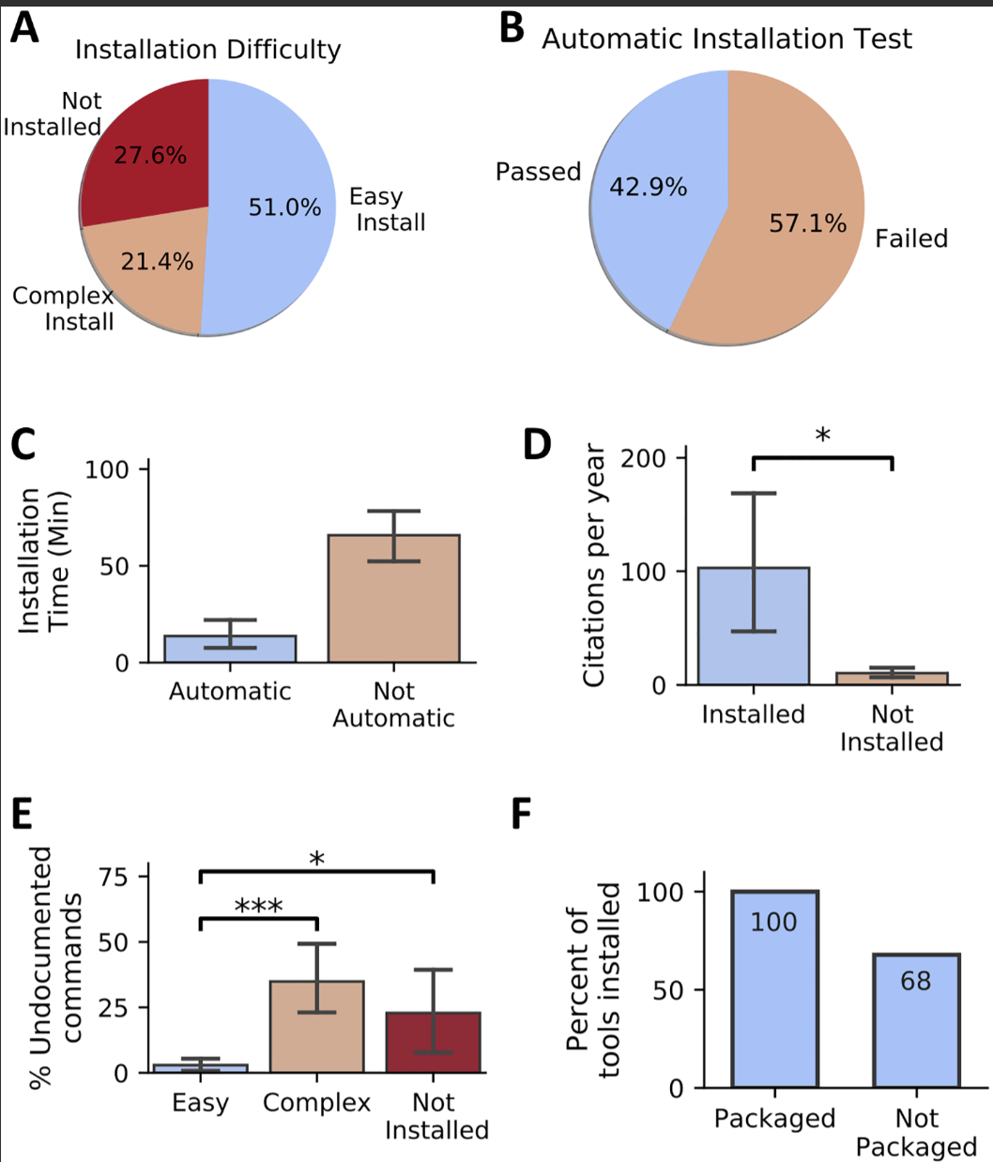
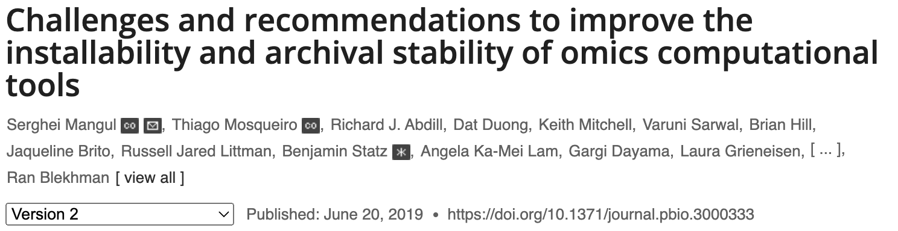
Why do we need a Community effort?
28% of all omics software resources were not accessible through URLs published
Among the tools found, 49% were difficult to install or could not be installed at all!
Notes:
Even repeatability is very hard. In this paper in all these papaers analysed they found …

Slide 13
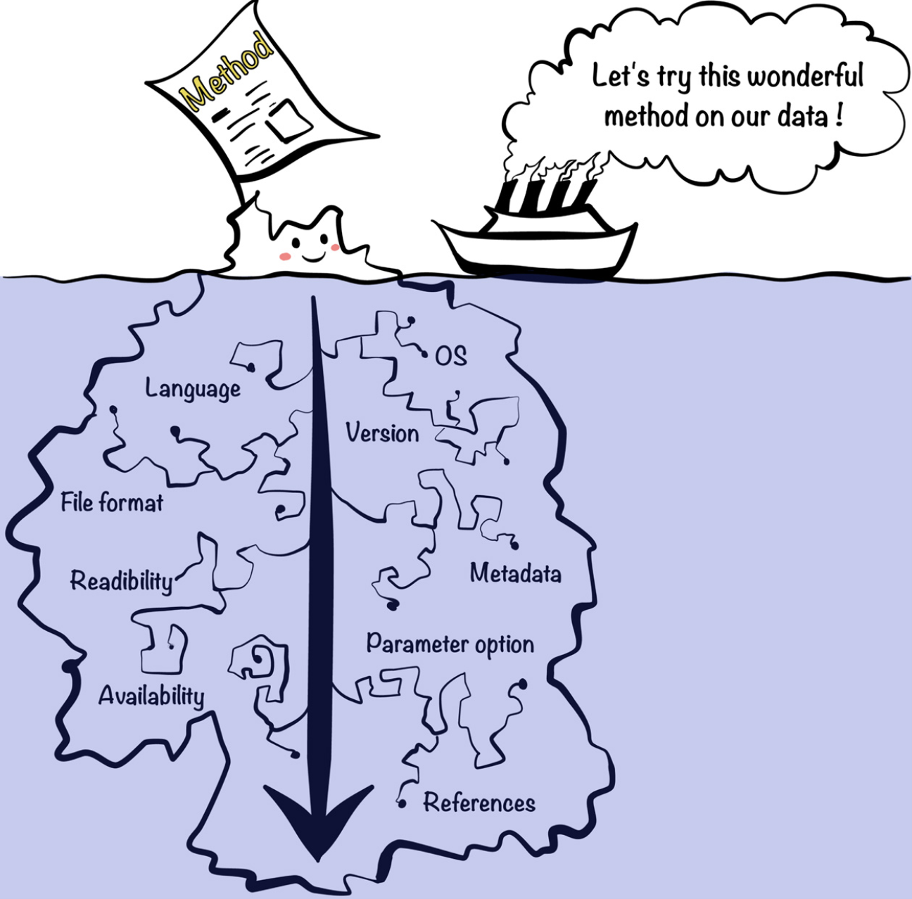
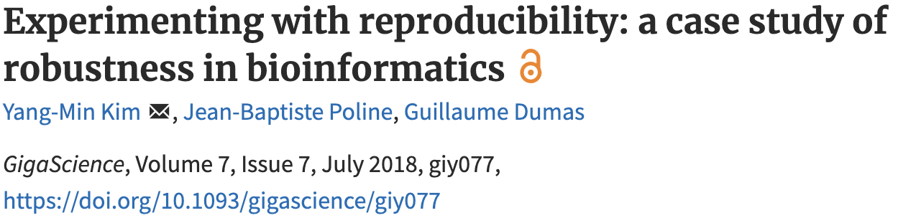
Why do we need a Community effort?
"First we tried to rerun the analysis with the code and the data provided by the authors. Second we reimplemented the whole method in a python package…"
Notes:
Very common in bioinformatics and data science we want to try a new method. Commonly even though you have a version of a software there’s a lot more information required to run this software.
In this paper reerenced here they assessed robustness in bioinformatics and they wrote this sentence that should us think about.

Slide 14
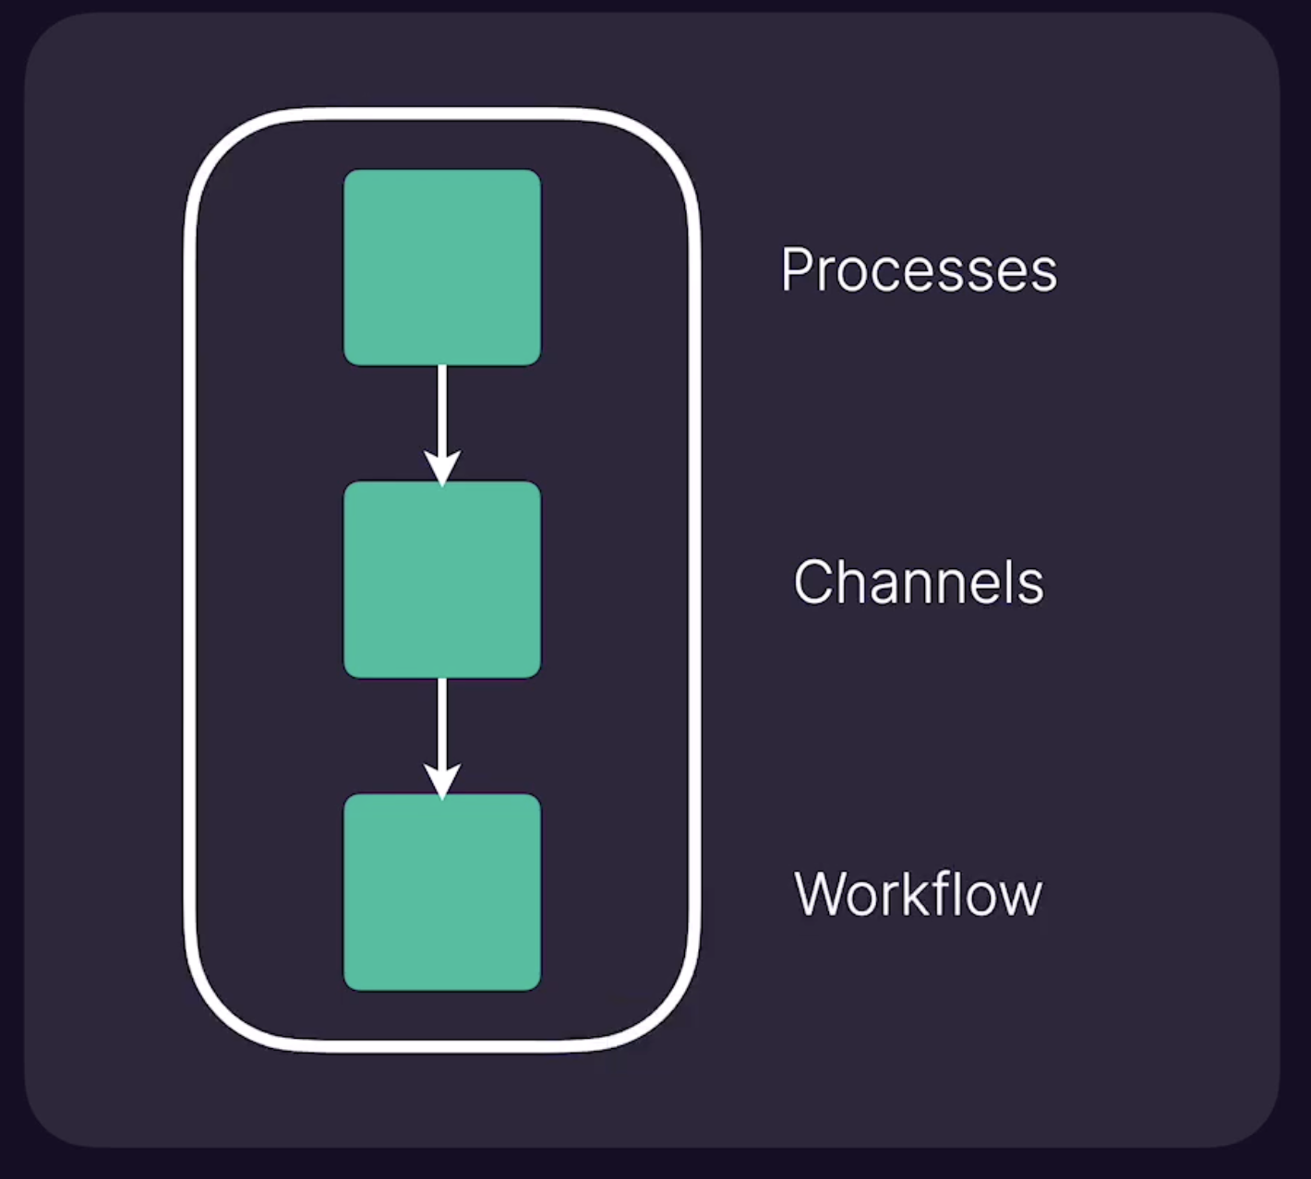
Nextflow is based on few primitives
Process is every step in your pipeline, and they are executed independently isolated from each other
We need something to share inputs and outputs between processes, these are the channels and there are different ways to build those
When you have a set of processes and channels coonecting them we have a workflow
Notes:
Nextflow is based on few primitives:
Process is every step in your pipeline and they are executed independently isolated from each other
We need something to share inputs and outputs between processes, these are the channels and there are different ways to build those
When you have a set of processes and channels coonecting them we have a workflow

Slide 15
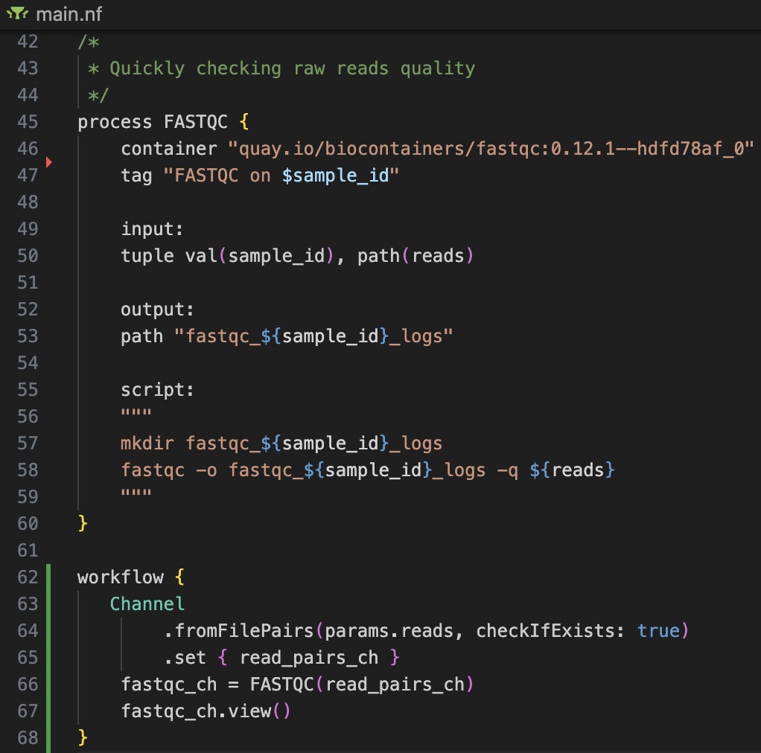
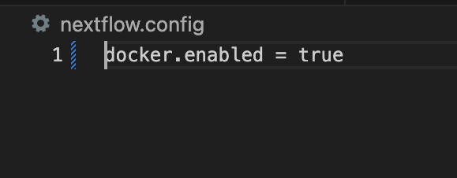
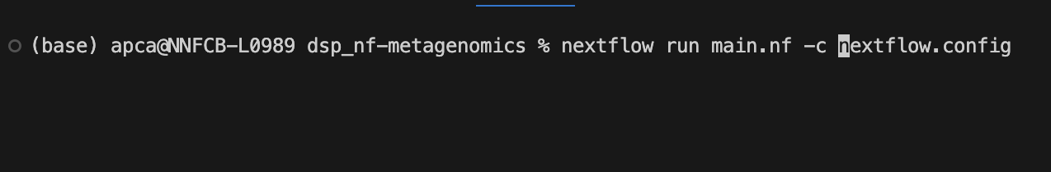
A Nextflow script
The .nf files are workflow scripts
The file nextflow.config is a configuration file that sets minimal environment properties
Directives
Process
Code block
How to run it:
Channel
Workflow
Notes:
Here you have a Nextflow script that I wrote.
Usually it will have 1 or more processes and a workflow in the end that indicates how this workflow is going to be executed and what are the cannels connecting the different processes.
If we look at the process, we have different parts:
- the name of the process, here it was a process to do fastQC on sequenced reads
directives: tell th process which docker image needs, which tage needs to be printed
then it comes the input passed as an structure called tuple
then the output, which in this case it is a path
then the code block, which in this case in bash commands
Finally it comes the workflow part, where we first create a channel with the reads files that is passed to the fastqc process and finally we want to view the process output files
This script it usually needs to be in the same folder as a config file that sets some minimal environment properties to run the script

Slide 16
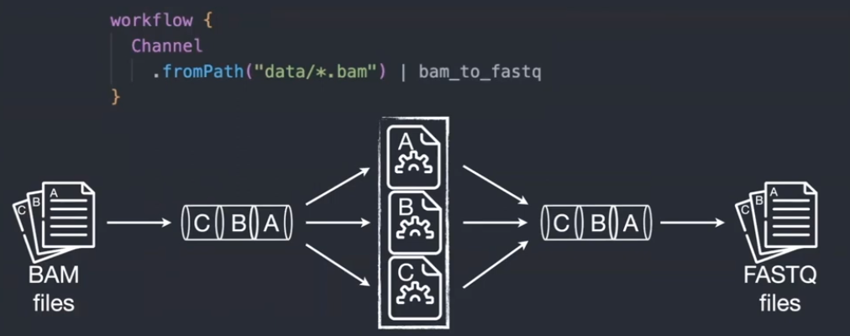
Nextflow – Interesting features
Implicit parallelism (tasks in a process are run by default in parallel)
Reentrancy (resume partial runs, do not need to rerun the entire pipeline when something went wrong, it starts from wherever it stopped)
Reusability (reuse different modules, subworkflows, written and containerized by the Nextflow community)
Notes:
Some interesting features of Nextflow are implicit parallellism, reentrancy and reusability.
In this example here we have a channel of bam files that is the input for a process that turns bam files into fastq files. In the scheme is shown that all the bam files are by default processed in parallel producing another channel as output of fastQ files Reentrancy means that you can rerun a pipeline from wherever it stopped. This is extremely useful in general but particularly when you are developing a pipeline o running one that takes too long and for whatever reason it stops. You can resume partial runs, do not need to rerun the entire pipeline of something went wrong, it starts from where it stopped
Finally it is great that we can reuse different modules, subworkflows, written and containerized by the Nextflow community

Slide 17
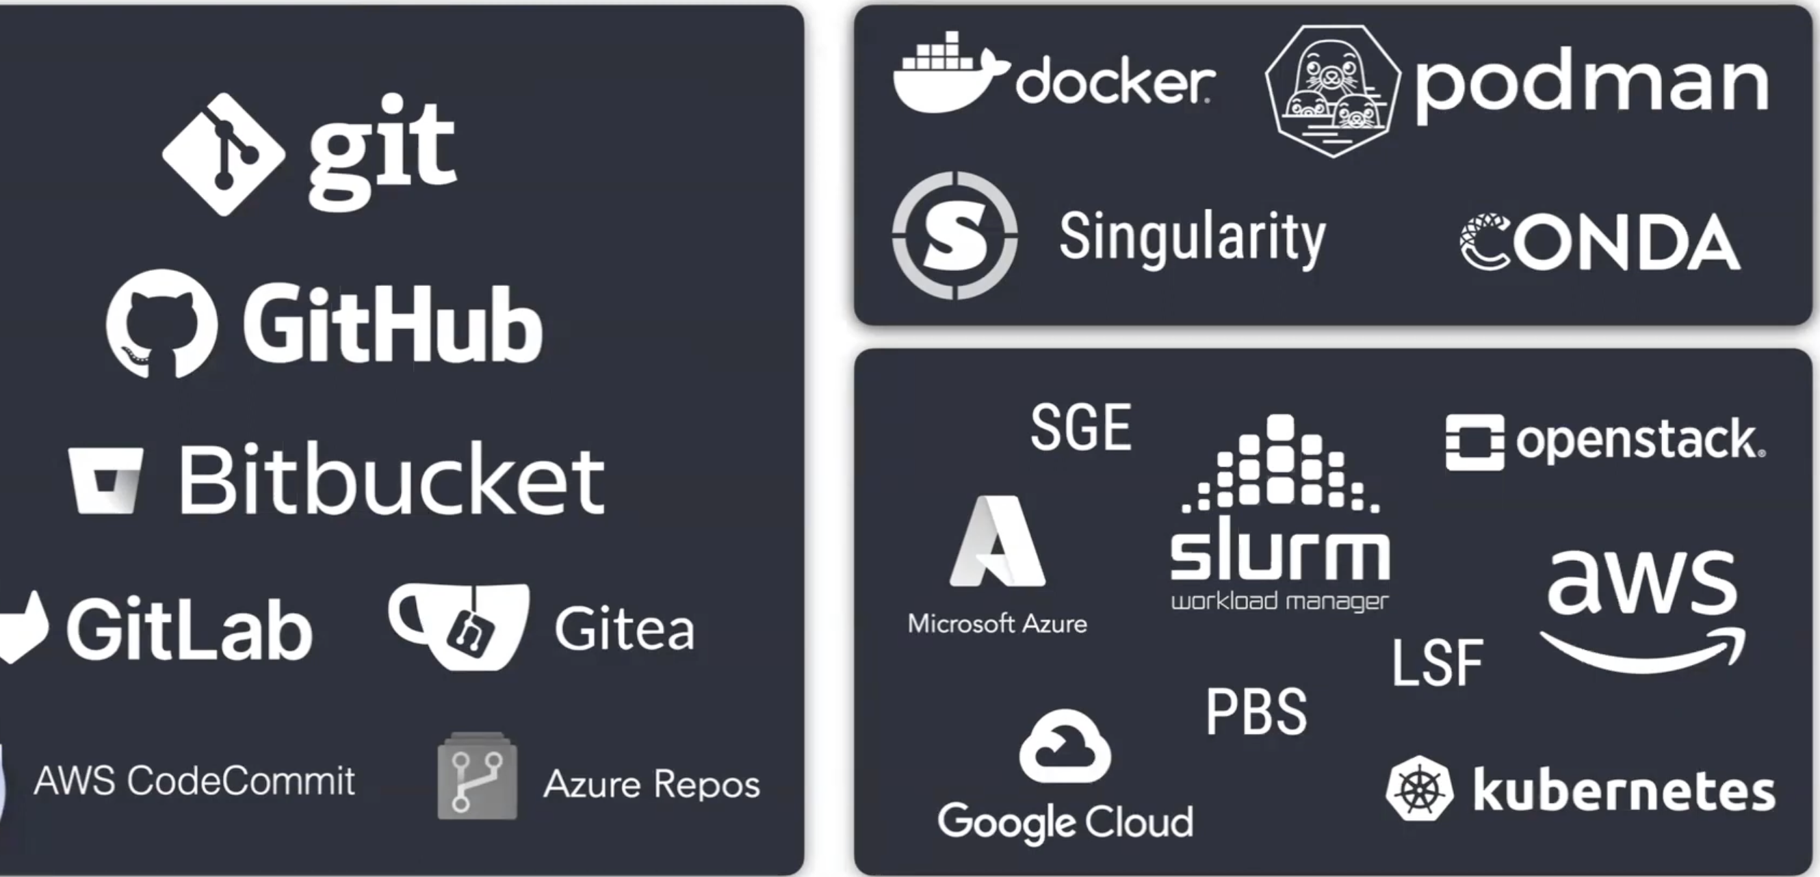
Languages, Software and computing environments
Nextflow it supports many version controlled you can host your code there and run it directly from Nextflow
Nextflow supports most of the containerizing options like Docker, Singularity or Conda environments, etc …
Same thing for computing environments, it supports supports the main cloud infrastructures and most of the job schedulers of HPC
Languages
Software
Compute
Notes:
Different aspects of nextflow, Nextflow is a software and a language to build your workflow
We need software to run the pipeline and an environment to run it
Language it supports many version controlled you can host your code there and run it directly from Nextflow
What it comes to software Nextflow supports many containerizing options like Docker, Singularity or Conda environments, which is very important for portability and reproducibility
For computing environments supports the main cloud infrastructures and ,ost of the job schedulers of HPC

Slide 18



Nextflow’s core features
Reproducible between runs
integration with code management tools
all packages downloaded, organized in containers, and control over computing environment
Portable between systems
you can write the code in your laptop and can run everywhere (HPC, cloud)
works with most of computing environments
Scalable
it can be run for 10 on your laptop or thousands of samples in an HPC or the cloud
Integration of existing tools, systems, and industry standards
Notes:
Let’s talk bout the core features of Nextflow: It is reproducible Portable

Slide 19


A global community effort to collect a curated set of open‑source analysis pipelines built using Nextflow. https://nf-co.re/
118 pipelines available (27th November 2024)
to process and analyse many different data types
Modules: 1,163 reusable components that can be integrated into pipelines
Subworkflows: 72 pre-assembled combinations of modules aimed at streamlining commonly used workflows
Notes:
Originaly were Genomics pipelines but now thee are many other pipelines to process all data types
118 pipelines available to do 118 different bioinformatics analysis
They have also >1000 modules that are reusable and can be integrated in other pipelines as you wish
And also 72 subworkflows (combinations of modules) that can be also combined with your workflows

Slide 20


Tools
Running pipelines
Writing pipelines
Testing/linting
Validating
Automation
Community
Developing with the community
Standards – Use common templates
Best practices defined
Followed globally and through many social media channels (Slack, hackathons,…)
Collaboration – No duplicate pipelines within nf-core
Different modules and subworkflows need to be compatible
Notes:
nf-core tools to run pipelines, templates to start writing our pipelines, and tools for testing, linting, or validating
nf-core is build by the community (us using it) so it is being developed with the community
common templates,
best practices,
followed globally through social media
colaboration no duplication: one pipeline per analysis
All different components need to be compatible

